Slide 1
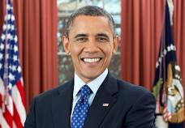
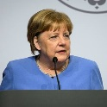

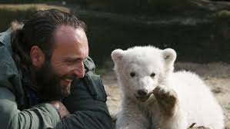
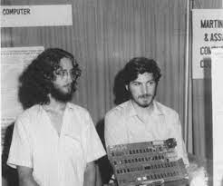
FBI
development
CPVA.2014
SAVE!
(delta)
White.God.St.Peter.v2. aei.maxplank.marx
nonPoliceGroups
Desperate German Housewifes
DTCC
Cloud computing communit forum(CCCIF)
88th
Micky Mouse Club House
300 VP GERMANY Cakl you rice
nonPoliceGroupLogial
FBI:WMD
nonPoliceCfg.nonPoliceTown(Dublin)
Daniel
Steve: Boy’s Town
D
Guy itting out front reading
paper in welder suit and job
CHART
1994 Internship
`1995 Apprentiship
Save Shamu
Los Gatas -> Dublin
DR JOESPHE:
Knut North
Gorbach(Sap, Dr)
Save Knut, St. Peter
White.maxplank.aei.marx.Visa
nonPoliceAudience.nonPoliceMpa.nonPoliceCfg
NAVY
father waits for job, son has job, son read newpaoer, steve: boystown
Wait phil(MILITARY.(daily)retimetn burnch).nonPocileQOS
INTERUPTS
2000 CHECKPONT CHALIE(x/y DEA(mdma))
INT.NAME CHANE(free pizza)
Meeting Daniel to go to Berlin, Loveparade
Long hair, Long hair: SQ.COLEMAN.NAME CHANE(freezpizza).DESERT STORM(salem)
Crreated remote long hair NAMECHANE(freepizza)
Daniel: due siehst aus wie ein wilder kalfornier (trnl) you like like a wild calfonian

Slide 2
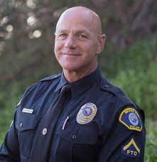
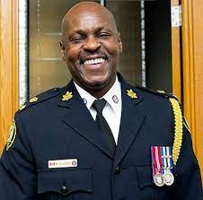
FBI
development
WW2.CIVIL CODE(bald/bald)
SQ.PENTEGAON(DEERE PARK AVE)
INSURNACE
RICH(ARD)
AVABILITY
MARY
KITO
Thomas
NAME CHANGE(Saint Thomas,free pizza)

Slide 3
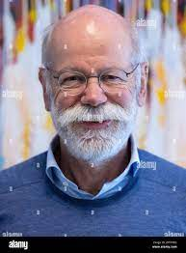
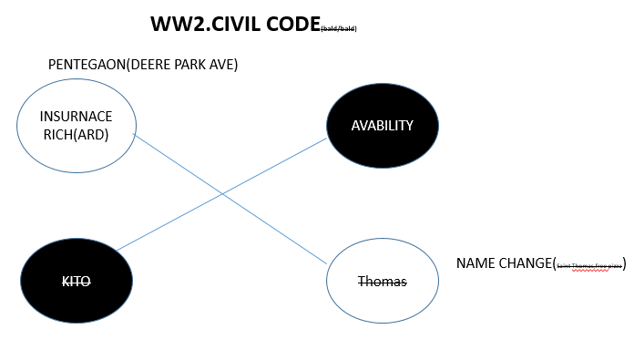
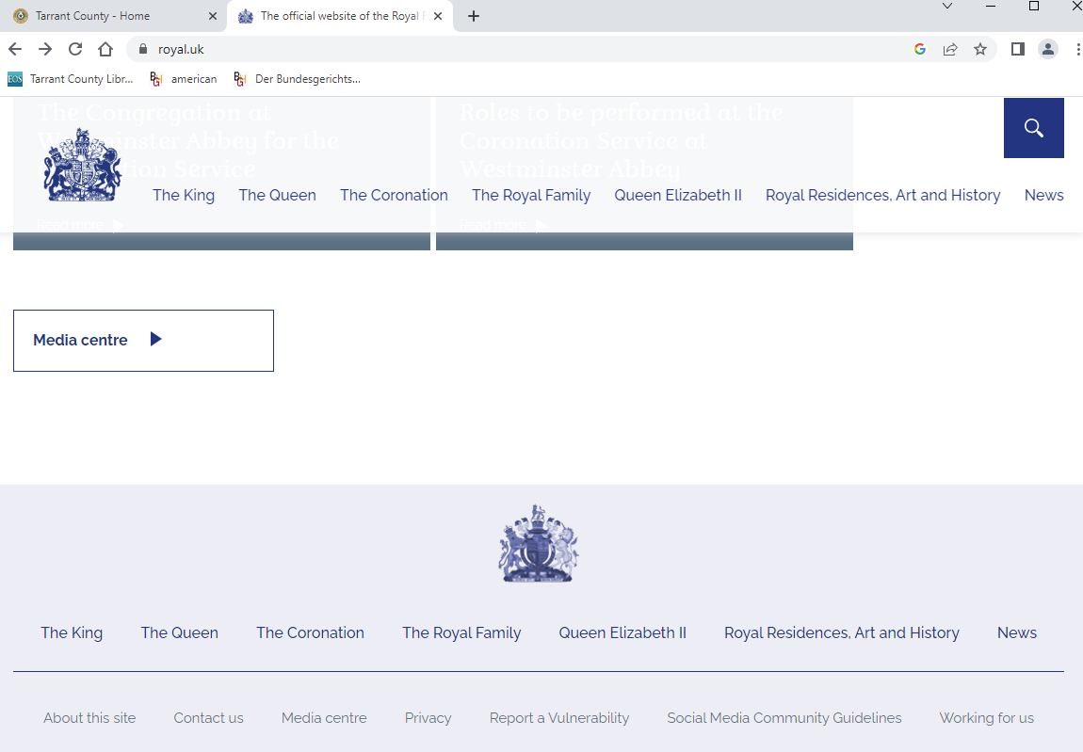
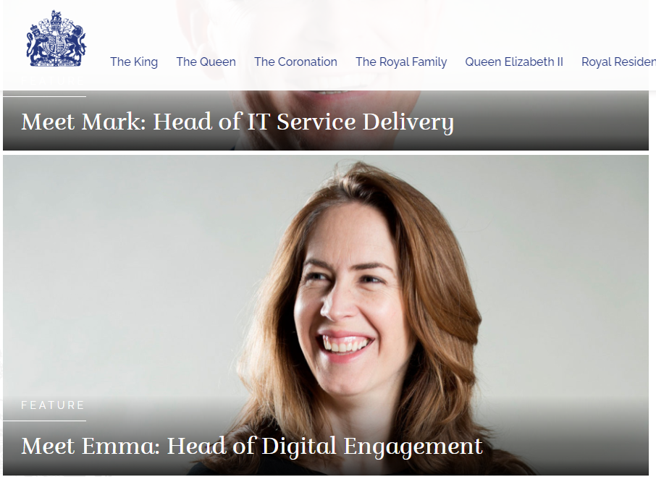
FBI
development
2017 England Entry
1521 England
“Baron Red”
KING.Arthur
Thomas Wieland
Front Gate
Thomas-is-dr.dieter
HOMCIDE:FRIEND(alfonz)
IPX Arthur/atur
INTERVIEW: “Castle Page”
https://www.royal.uk/
Workign for us
Alg: same

Slide 4

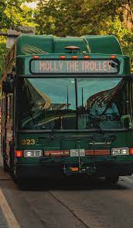
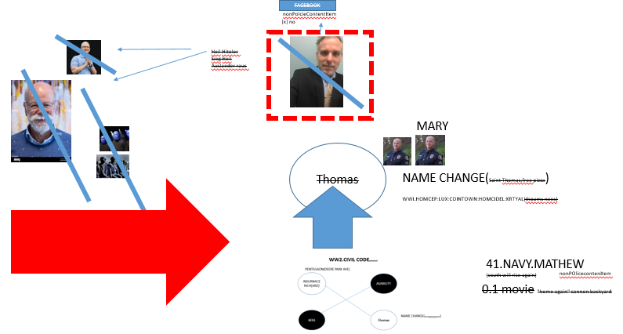

FBI
development
Guy is bus driver of CIVIL CODE
violators on ATOMCLOCK
v2.ATOCLOCK(88^{th)}.repeat
[x] no
Emma is currently Head of Digital Engagement. As part of Royal Communications,
monarchy website and social media channels

Slide 5




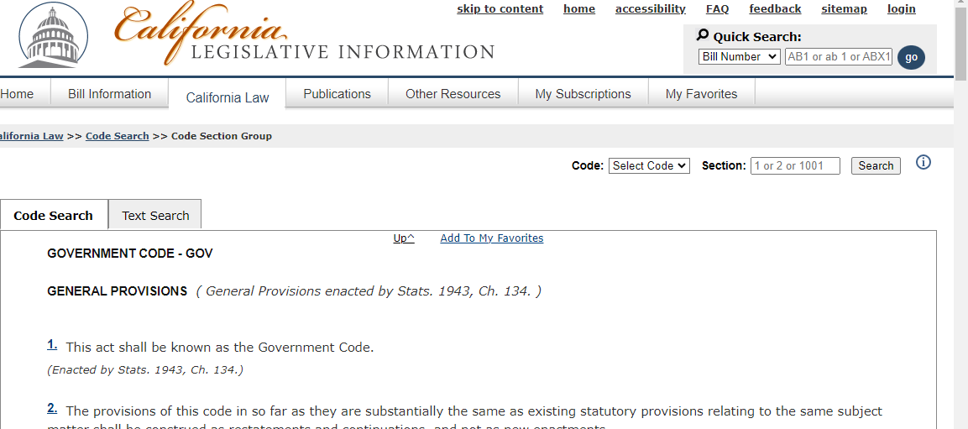

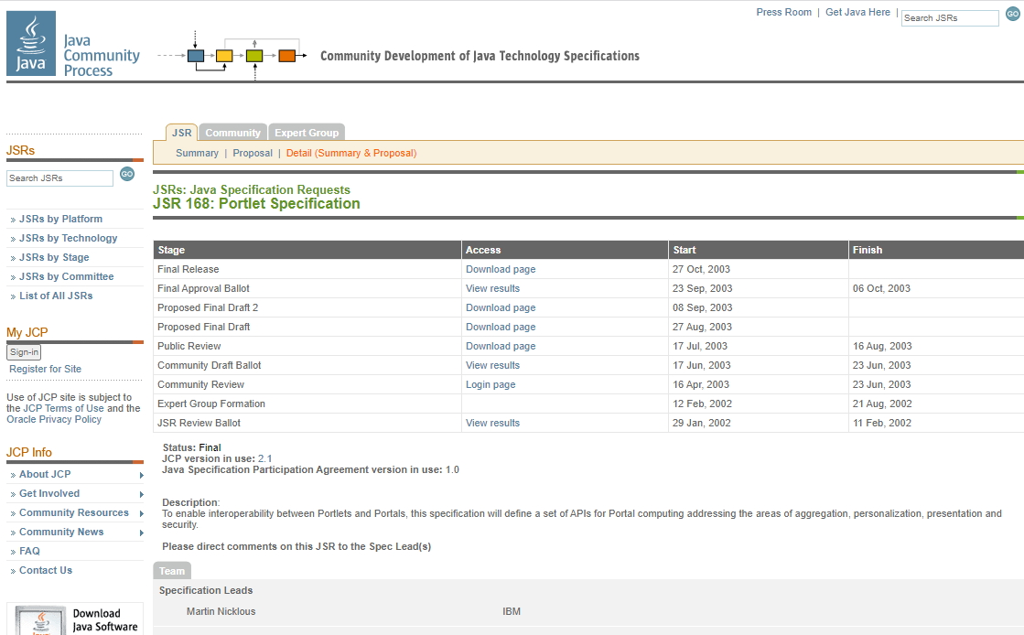
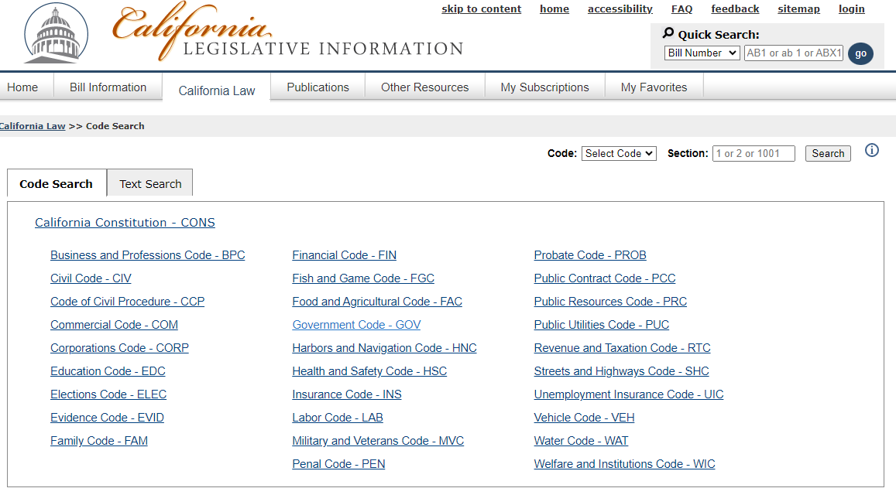
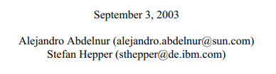
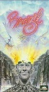
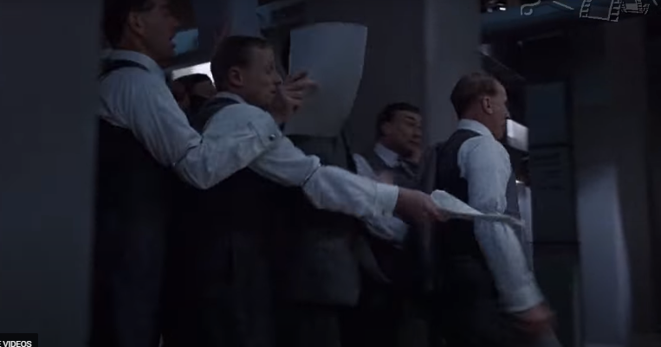
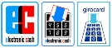
FBI
development
MONOPOLOY
FBI:WHITE COLOR CRIME
CHECKPONT CHALIER(Car, Rockefeller, Money)
NAME CHANGE(free pizaa, Rockefeller, bist du rockefler oder was(trnal are you rocefelle ro whate)
0.01 beate tui/ltur AVAIBLITY.king.roth.ibm.damiler.
Travel: lufhansa(tui/ltur).davidson(thomas-is-dieter)
GOVEMNT CODE.AVABILITTY
GENERAL PROVISIONS
( General Provisions enacted by Stats. 1943, Ch. 134. )
IBM JSR-168
jcp.org
FBI:WMD for Court(Santa Cruz)
Gov Code
0.1
Apple.slashdot
Code
police sirens
NAME CHANE(freee pizz)
0.01
Greek Thomasse Deere Thomas
Allianz
Finshed Intership, leaving
Christian falta
Edward
Googl pay
Apple pay
Pay
v.Me
Amazon pay
§Theft

Slide 6

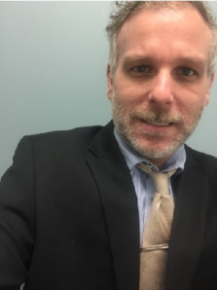
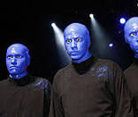
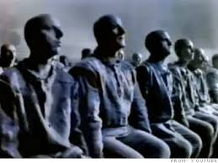
FBI
development
FACEBOOK
nonPolcieContentItem
[x] no
Heil Hiteler
Sieg Heil
Auslaeder raus
MARY
Thomas
NAME CHANGE(Saint Thomas,free pizza)
WWI.HOMCEP:LUX:COINTOWN:HOMCIDEL:KRTYAL(thoams nees)
41.NAVY.MATHEW
(south will rise again)
nonPOlicecontenItem
0.1 movie "home again" cannon backyard

Slide 7
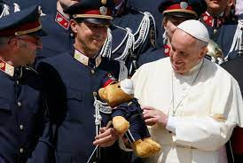
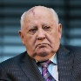

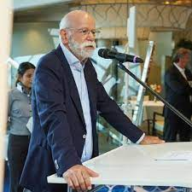


FBI
development
CHECKPONT CHALIER(Car, Rockefeller, Money)
Beathe?: Dom roles royec
[x] no
CHART
IMPORT beate ghoceh(dell.client.beath.ushe)
ddr
beate
1995 GAS(rudolf-deisel-strasse)
INTERUPTS
Itaien:HOMCIDE:AUSLAENDER
1995 Ghoeh(depress
,DEA(mdma)
.nonPoliceNiklouse
Sovietn union
beate
2000
Ausschiwt(bahnhfostrssse,siemens-> PENTAONG.deeere)
000.tw.pns.(bra,0c)
Hang off roof at food shlter chruch
beate
2023
HOMCE:LUX:CONITIN
DEA
HOMCE:LUX:CONITIN
beate
1994 INTERSHIP
2014 EMPLOYEE, 20Y
beate
PENTAON:DEA.CHECKPONE CHAILE(steven boyfriend toydepamrent)
Do you want vans they are from califrona( I am moving to califonai)
You are an idiot
41.tomboy
beate
2015 ATOMCLOCK(CPVA.MARY IPX 1995 (GAS)

Slide 8
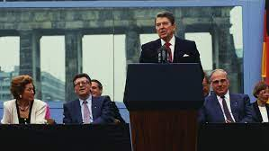
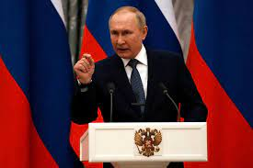
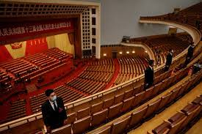
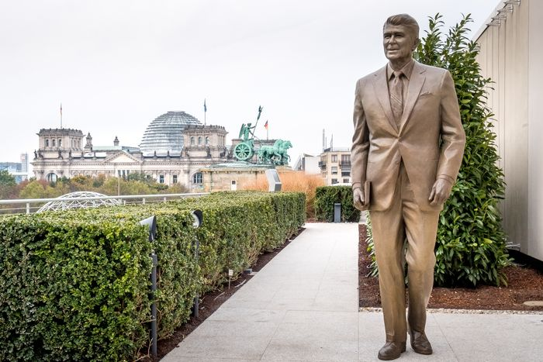
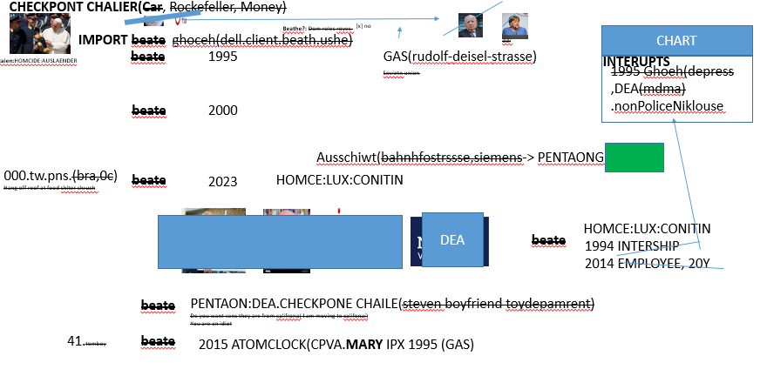
FBI
development
CHECKPONT CHALIER(Car, Rockefeller, Money)
ddr
We have done this before …
Beate[]: 1994(Car), 1995,(Gas), 2016(DEA(apple))

Slide 9
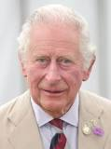
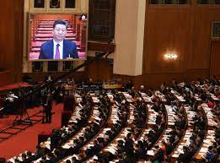
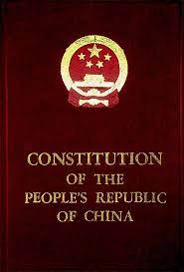
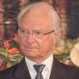
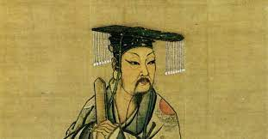
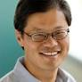
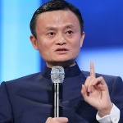
FBI
development
0.1 chines work harder, indian spell better
e British Army during the First World War fought the largest and most costly war in its long history
NAME CHANE(free pizza, Peterstosn house)
PETERSSON
Congress china dynasty leglation
People's Congress on December 4, 1982,
Xia Dynasty
The Great Qing Code
yang
ma
The initial imperial Chinese legal code, that of the Qin This act ended the rule of. China's last imperial dynasty. The new Chinese republic based its laws on the German law code, as Tai- wan still does today. (221–206 bce),
ATARI.TANGO
nonPoliceID
Dev-eng.avg
http://www.npc.gov.cn/englishnpc/constitution2019/201911/1f65146fb6104dd3a2793875d19b5b29.shtml

Slide 10
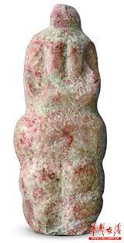

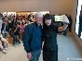
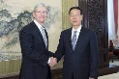
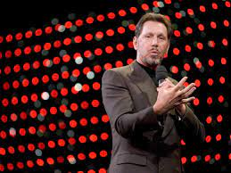
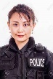
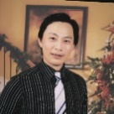

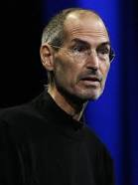
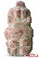
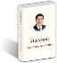
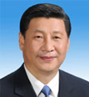
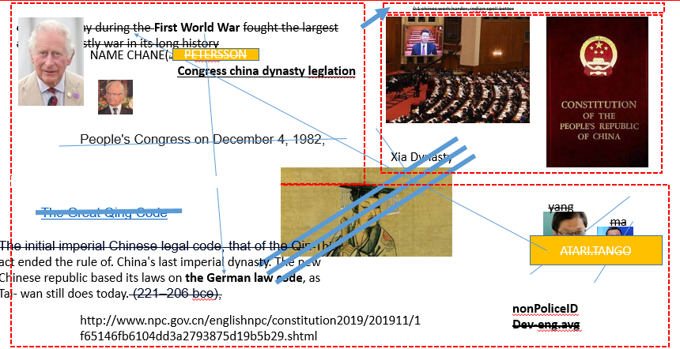

FBI
development
Application
Reporter
Marketing
China Government Artifacts ( gov.cn )
Catholic
He is now catholic
Download
job
Sales
0.1 print a gun
filoli woodside chinese artifact
z/os deere
Collect an Artifact from a Chinese Dynasty
Congress Xi.nonPolciDoucmentsLogical
President Xi
Jinping
0.1 Civli Code Violater(delayed): Arthy Tshan IBM

Slide 11
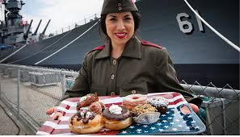
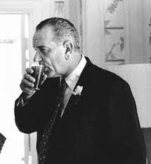













FBI
development
POLICE:MILITARY:RETIRMENT
JOESEPH
CIVIL CODE
LABOR CODE
vacation
[x]no
41.POLICE:BRUNCH
nonPolcieQOS
(daily)
NAVY:MILITARY:RETIRMENT

Slide 12







FBI
development
FBI:WHITE COLOR
CHECKPONT CHALIER(Car, Rockefeller, FEDEAL BANK)
Continetnal Breafast
HOMICDIE:NANA; HOMCIDE:LUX
[x] no
Monpoloy
LIFE
41.NAME CHANE
free pizza, miltoin-bradely; mb
Atlatic Hotel(cluedo)
Schiwimmen,mau-mau
Clue
I am going to the neighbor house to play bridge. We played brigh with the naeibhros
https://bicyclecards.com/how-to-play/bridge
41.Bridge
Skat
0.01 2000/1Stehane Continetnal Breafast = 0
1986/7
0.1 Public Disturbance linsti(bitch)

Slide 13














FBI
development
FBI:WHITE COLOR CRIME
SQ.CPVA.God.nonPolciTV(rockeffell plaza)
Rockefeller
0.1 koch(move field)
0.1 roth.wait
MONOPOLOY
Application
CHECKPOINT CHARLEY(Car, Rockefeller, FEDEAL BANK)
VIRGINIA
Daimler
Mercdes (Emma Helen Meiers)
Download
AVAILABILITY
CPVA.Payments
CPVA.CAR
All of the pople have rice
Monpoloy
FBI:KIDNAPPING
Personal Finances
CIVIC CDOE (default life)
Avalabiliy.rice.w/sam
WATER(n. brancifote)
ATB Govment Constraitions
Don’t take me water
I have your car

Slide 14


















FBI
development
Guy Stalking
VIRIGINA
-> tom cook-> male.avg.175lbs (i.e. workday, netlfix)
VINGINA.MARY[]
FBI:KIDNAPPING:
school supplies ueber
Brunet women standin outsie while shoping for school supple for daughter althog for myslef
SQ.CPVA.God.nonPoliceTV
rockeffell plaza
nonPolcieCfg.KOCMANE
FBI.Coke.Dalls Cowboys
karl
Richard Grasso
SALES
idiot
stanford
MAINSTREE(macdonai: se-se)
2014.CPVA.!WHITE.NAME CHENA(sam)
HOMICIDE:LUX
(scrooge travel cartons routes)
He would like to keep KOCHEMAN
Moving itms for living location
nonPolciHomellesLiaonLogial
Scrooge WWII flight routes
Travel
Africa
For Water(n. brancife)
Macadoe(Stanford)
CIVIL CODE violations
phil(bon dem bushe)
White.South Africa
Goheoh(dell.cleint).Vodaphone
Hbr
VIRGINIA
Boot Recoder
MBR Moodys

Slide 15







FBI
development
HOMICDIE:LUX:HOMCE:IS-A-BELL
US MILITARY FLIGHT ROUTES
TRAVEL: MILTIAYR RETIMRENT
Where is the money CPVA?
Travel Flights beate?
$
2000 WAR(b1→philll).WHITEHOUSE
[x] no

Slide 16


FBI
development
HOMICDIE:LUX:HOMCE:IS-A-BELL
US MILITARY FLIGHT ROUTES
TRAVEL: MILTIAYR RETIMRENT
$
2000 WAR(b1→philll).WHITEHOUSE
AFRICA
MAINSTRE(GOD.nonPolcieTuniasn(Singer,Piano ))

Slide 17


FBI
development
STEIN

Slide 18







FBI
development
Alen.maxpalnak.aei.marx(
Expansion
Serbien,bosian,medeusli
Mekerl (couterstrike)
philATIMFCORY(phipsburg):
Comand and conquer IPX
dnaiel conmman and qonqu
HOMICDIE:LUX:HOMCE:IS-A-BELL
US MILITARY FLIGHT ROUTES
TRAVEL: MILTIAYR RETIMRENT
$
2000 WAR(b1→philll).WHITEHOUSE
AFRICA
2000 WATER(Breakfast)
NAME CHANGE(Atari free pizza)
COY Consutaino
STATUS(avg): Rice
Constution(Original)
MAINSTRE(GOD.nonPolcieTuniasn(Singer,Piano ))
ATOMCLOCK(tim).STARBUCEK(FRED; gary)
CONSTUTOIN
IPX
SALES
$
2000 WAR(b1→philll).WHITEHOUSE
nonPolciPresident(von dem Bushe).NAME CHANGE(free pizza; to change name bush)
nonPolciHomeliaosn(sleepin in the bush)
Dom
LISSA
uwe
client
phil

Slide 19








FBI
development
Phil.nonPoliceTV.nonPolcieBrazil(ATOMCLOCK(tim)
0.1 FBI:KIDNAPPIG.AVAIBLITY.$.nonPolciBrazil
China.FBI:FRAUD:CREDIT (JP,JB,JP,JM)
0.1 SWAT.nonPolicOperaitonLogial.
1D8723(STATE OF ERMGENCY).MAINSTREET(HOMCEI:VHS:LUX)
2000 WAR(B-10)LARRY.JR/SR.WHITEHOUSE
1991 January
- Deutsch Mark
Mainteance of Eva Braun (mother-in-law)
1 Billion Europeans
Controlling Billionaires
[x]no
1)
2) Logical Billonaraires JOESEPHE
$
$
calc
0.1 ukraine
0.1 FBI:FRAUD:CREDIT
2000 WAR(b1→philll).WHITEHOUSE
2000 WAR(b1→philll).WHITEHOUSE
0.1 phil(kim) braun, verena
Theater Mamai Mia
Guy does stupid things
000.41CPVA.CONTROLLING.WII.AVAIBLITY
nonPoliceGroup(Mama Mia, Lion King, Nutcracker)
x/y FBI:WMD for Facebook and City
1D8723.GROUPS
FEDERAL BANK GERMANY: CONTROLLING

Slide 20




FBI
development
40Y Pipe 1990-2023
HOMICIDE:CHANZELOR
Europe
Legislation
Africa
Legislation

Slide 21








FBI
development
CPVA.CHINA.GERMANY
Marketing
Application
Reporter
2014.CVPA.$1M.
CONTROLLING
00001 fine HOMCE:LUX(china:sovie:union)
000
1 Billion Europeans
0.1 ¼.KOCHMAN
41.
g=3.14
Bathroom
MARY.Pms
Human Reosur.avg
$
2000 WAR(b1→philll).WHITEHOUSE
Kyle palces garabec can next to ladies bathromm of human soruces with period in front of bathroom. Befoe staling rolex from 1945 phil Patherough US-GERMANY-US
Sales
Download
Brwonie, veria,, mother-in-law
Added Lawyer
41.Visa.Coucie.Glu.Councle.Apple.Council
Controlling Trillionairs
(apple pay, aws pay,google pay)
11:59 division mortocyle

Slide 22



FBI
development
STEIN
MEIERS

Slide 23




FBI
development
KOCHMANN
December 2015
ATOMICCLOCK(Hermossa)
Banking Controlign Room
Stepna Walks into
0.1[] HOMCE:AUAENDER bad word
000.1 nonPociView
1987
movie
1996
field
2014
Steve house
corey
2023
My house chest
IMPORT
FBI:KIDNAPPING.nonPoliceCfg
2014
Steve house
CONTROLLIONG !BILLONARE(JP)

